Slide 1
Business Organization management
Student Name
Institution Name
Course Number
Due Date
Faculty Name

Slide 2
Beauty bridal shop
Beauty Bridal Shop is a wedding attire shop located in Oregon.
Based on the SWOT analysis the firms
strengths include:
    Effective one on one services, high gross margin and limited start up risk
    Weaknesses include
    Limited awareness on bridal packages, the shop is new, small size and staff
    Opportunities include
    Wide market unaffected by recession, and extension of other services.
    Threats include
    Limited population, inflation and social changes.
Competitors include Henry’s bridal boutique and Dreams Bridal boutique
The firm’s competitive strategy is broad differentiation strategy.

Slide 3
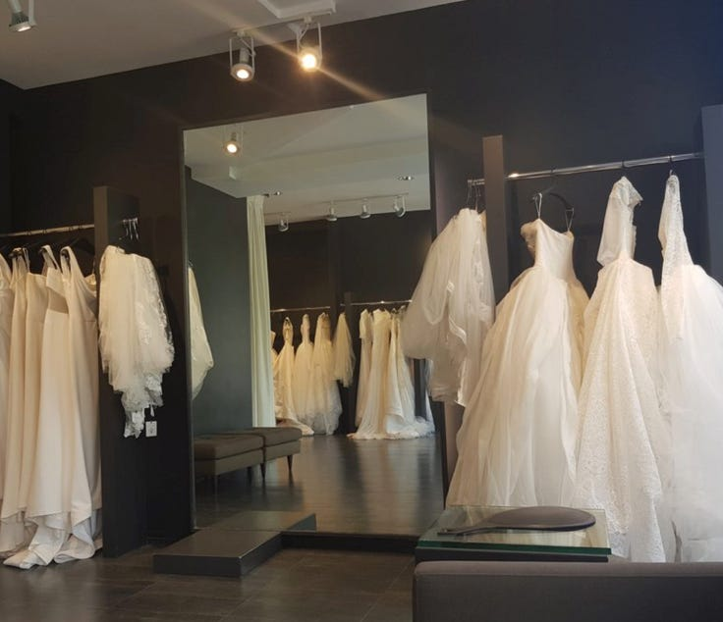
As a bridal shop we major on the experiences of our clients.
We major on developing a memorable and also pleasant experience for each person in the firm.
The firm main structure is functional where people that do similar roles are grouped together based on their specialty.
It has a wide span of control which enables the managers to have direct reports.
The firms decisions are decentralized, this enhance the effectiveness as well as reliability of the firm.

Slide 4
Palton Consulting
Palton consulting is a firm which may be established to use palton in order to lower development as well as maintenance costs to businesses.
The firm requires an investment of $175,000 in order to support operations.
The languages that will be used for developing Palton tend to be freely available.
The firm’s main aim is to provide skill to the businesses which do not have them within their own resources.

Slide 5

The firm will provide similar technologies at a lower price employing the technology
Apart from the salaries that the staffs receive, the management has budgeted $5000 per year for every member of the staff to aid in covering other costs.
Palton consulting may approach marketing from community of Palton users built around the website as well as advertising in industry publications.
The firm can target clients through the use of a combination of languages and platforms.
Palton makes use of a modular language definition technology and thus the firm has the ability to adapt very fast to a new language developments.

